Slide 1

PANIMALAR ENIGINEERING COLLEGE
Mobile application development
SHIFT FLOW
21CS1512-Social Relevant Mini Project
SUBMITTED BY :
Prathiba D [211422104347]
Prathiksha J [211422104348]
Mentor :Dr. Shyamala Devi

Slide 2


SHIFT FLOW
ABSTRACT:
The Employee Performance Digital Dashboard is a powerful tool that can help organizations improve employee performance and achieve their strategic goals. It provides real-time insights into key performance metrics, enabling organizations to identify areas for improvement, track progress towards goals, and make data-driven decisions. The dashboard integrates multiple data sources, offering a centralized platform for tracking KPIs such as productivity, quality, engagement, and attendance. It features customizable views tailored to different roles within the organization, allowing managers and HR professionals to monitor individual and team performance effectively. By presenting critical data in a clear and actionable format, the dashboard helps identify high performers, pinpoint areas for improvement, and support data-driven performance reviews. The dashboard promotes transparency and accountability, fostering a culture of continuous improvement and employee engagement. Implementing this tool can enhance decision-making processes, increase productivity, and drive strategic growth through more effective performance management.

Slide 3
Software Components:
Task Management Component:
Notification Component:
Performance Tracking Component:
This component allows managers to assign tasks to employees and review submissions. It supports multiple formats (text, PDF, document, PNG) for task uploads and updates task status based on manager feedback, ensuring efficient task tracking.
Using Firebase Cloud Messaging (FCM), this component sends real-time notifications to employees when new tasks are assigned or updated, and alerts managers when tasks are submitted. It enhances communication and task accountability.
This component visualizes employee performance through pie charts for employees' daily progress and bar charts for managers to review overall performance. It retrieves task completion data from the database to provide real-time insights.

Slide 4

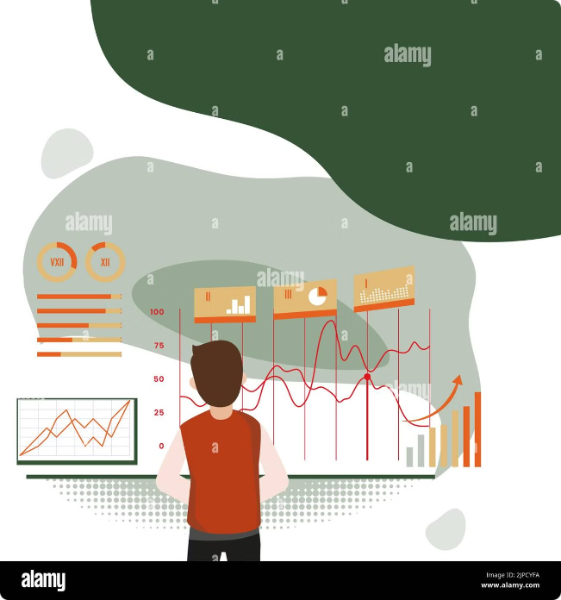



Hardware componensts
Processor
A good processor like Intel i5 or higher is needed to run Android Studio smoothly and handle your app's development tasks efficiently..
RAM
At least 8 GB of RAM is required to run Android Studio and other tools without slowing down your system, with 16 GB being ideal for better performance.
Storage
A 256 GB SSD provides enough space to store your project files and ensures faster loading times during development and testing.

Slide 5

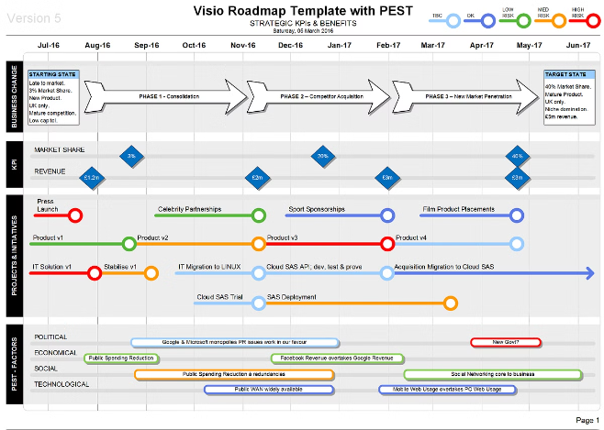
Implementation Roadmap
1
Planning and Design
Define objectives, select key performance indicators, and design the dashboard's interface.
2
Data Integration and Testing
Integrate data sources, configure data visualization elements, and test the dashboard's functionality.
3
Pilot Launch and Feedback
Pilot test the dashboard with a select group of users, gather feedback, and make necessary adjustments.
4
Full Deployment and Ongoing Monitoring
Roll out the dashboard across the organization, monitor performance, and continuously improve the tool.

Slide 6


Benefits of a Digital Dashboard
Enhanced Decision-Making
Improved Employee Engagement
Access real-time performance data to make informed decisions about resource allocation, training needs, and performance improvement strategies.
Provide employees with clear visibility into their performance, foster transparency, and promote a culture of continuous improvement.
Increased Productivity
Data-Driven Feedback
Identify areas for improvement, optimize workflows, and empower employees to reach their full potential.
Facilitate objective performance reviews and provide constructive feedback based on quantifiable data.

Slide 7

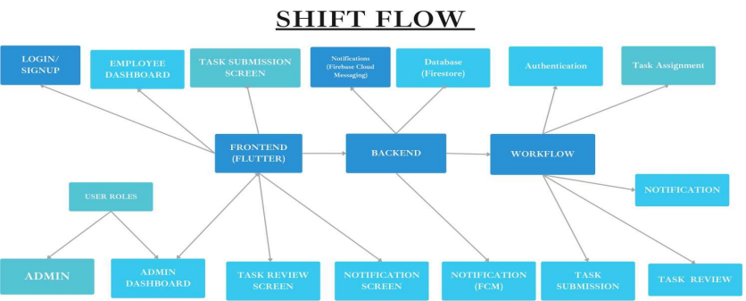
ARCHITECTURAL DIAGRAM

Slide 8
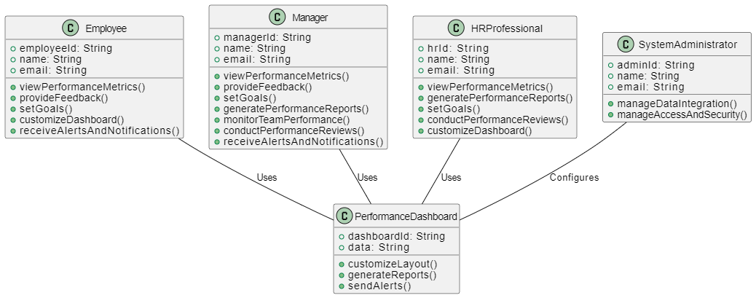
CLASS DIAGRAM

Slide 9
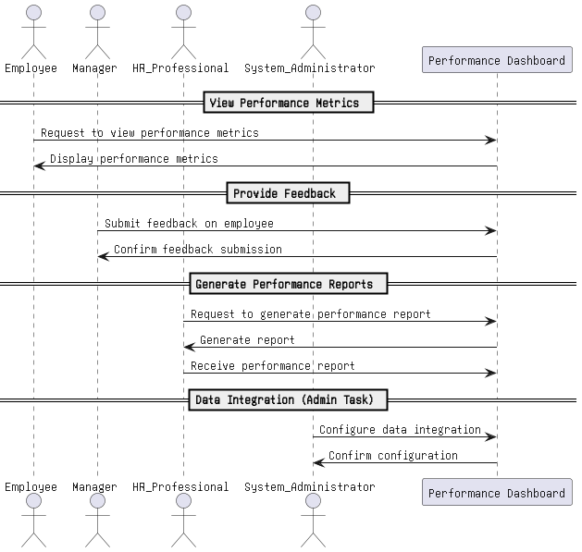
SEQUENCE -DIAGRAM

Slide 10
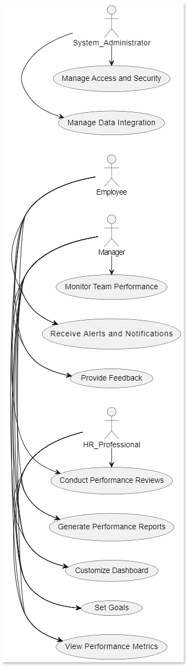
USE –CASE DIAGRAM

Slide 11

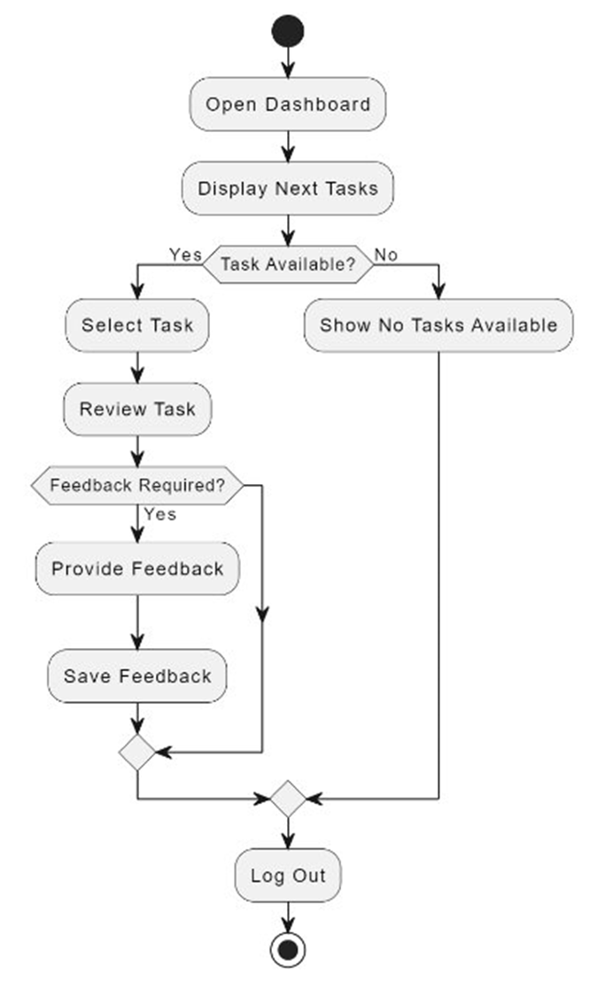
ACTIVITY-DIAGRAM

Slide 12
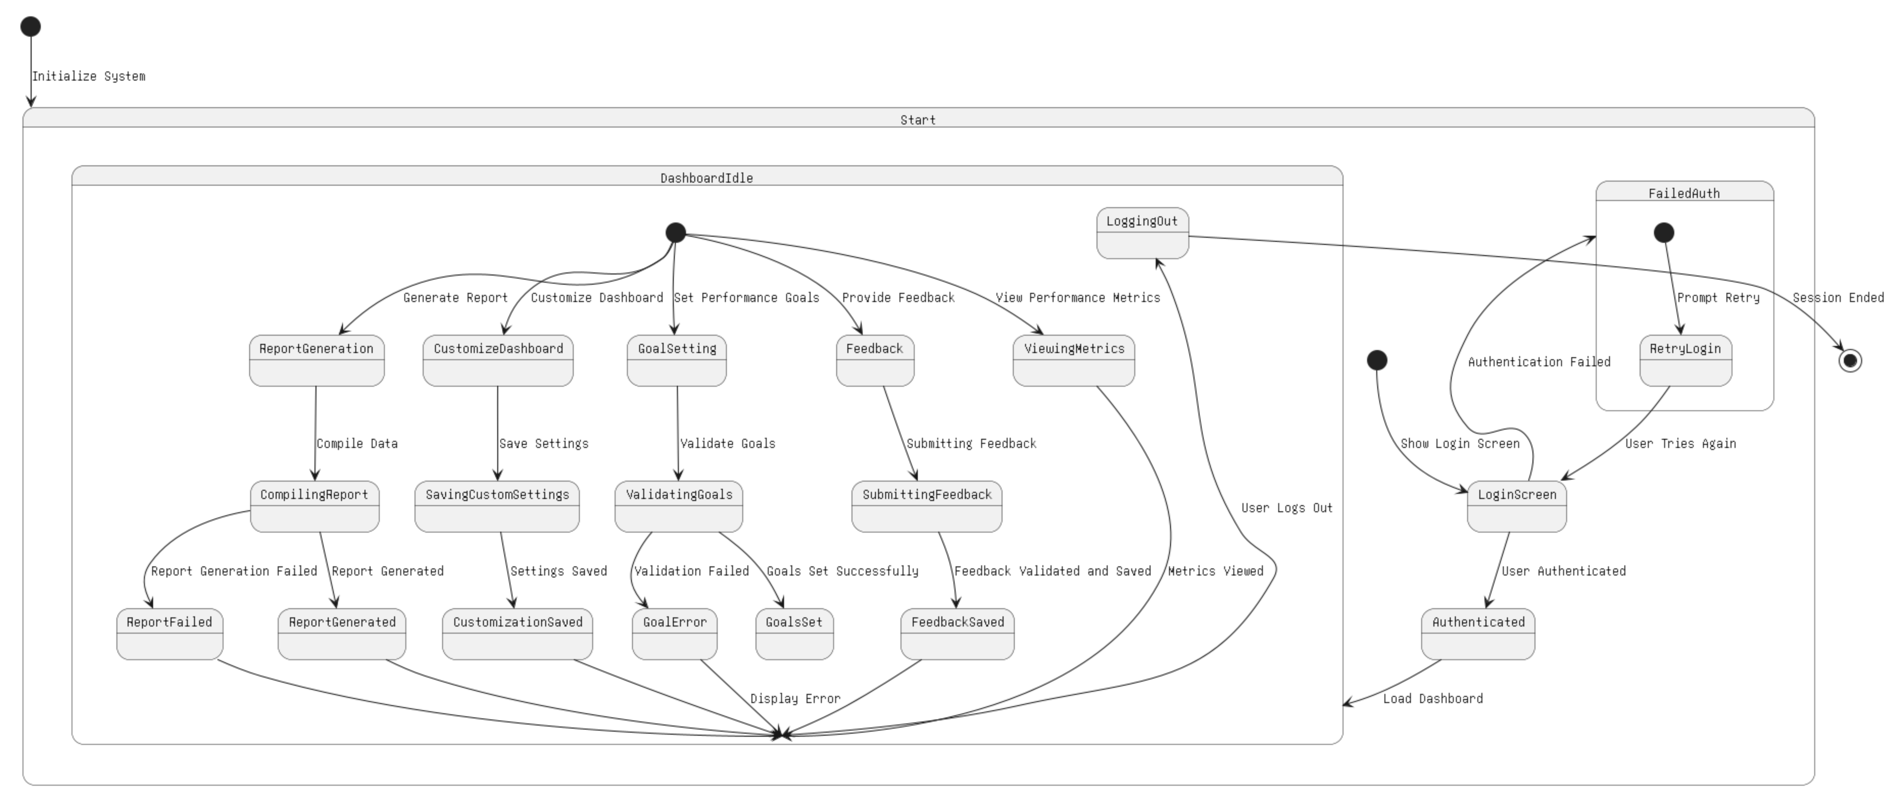
STATE-DIAGRAM

Slide 13
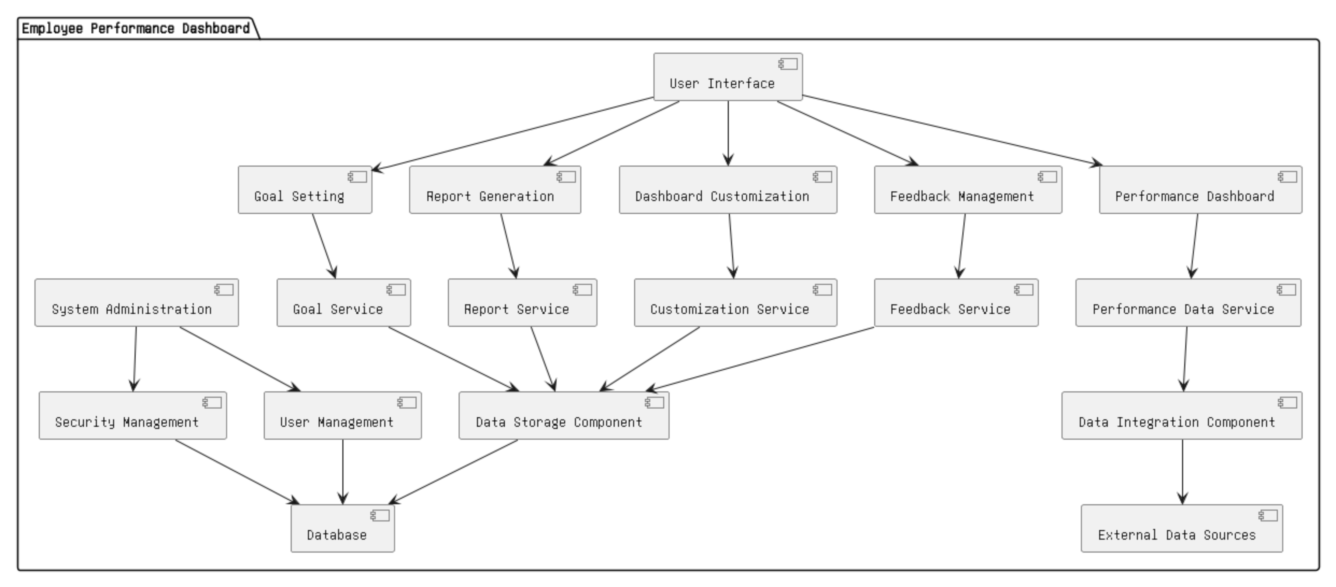
COMPONENT -DIAGRAM

Slide 14
MODULES
User Authentication and Authorization: This module manages secure login and registration for users (Managers and Employees). Role-based access ensures that only authorized users can perform specific tasks such as assigning or completing tasks.
Task Assignment and Submission: Managers can create tasks and assign them to Employees with details such as deadlines, formats (text, PDF, document, PNG), and priority. Employees can submit completed tasks for review.
Real-time Task Feedback: This module allows Managers to provide real-time feedback on the submitted tasks. Employees can view the feedback instantly, enabling continuous improvement and efficiency.
Performance Monitoring: Tracks Employee performance by generating visual reports. Managers can view overall performance in bar charts, and Employees can view their daily task breakdown in pie charts.
Notification System: Integrated with Firebase Cloud Messaging (FCM), this module sends real-time notifications about new task assignments, task completion, and feedback. It ensures timely updates for both Managers and Employees.
Instant Meeting Scheduling: Managers can create instant meetings with employees within the app. Notifications will be sent to the employees, and they can view meeting details (date, time, etc.).
Data Security and Key Management: Ensures secure data handling within the system. Using the KeyPairGenerator, encryption is applied to critical data such as task assignments and employee performance, ensuring privacy and security.
Cloud Deployment: The system is deployed on scalable cloud infrastructure for smooth and reliable operation. This ensures that the app is accessible across devices and can handle multiple users simultaneously without performance issues.

